Slide 1
AC2.1
Describe the operation of
the kitchen.
What does the term ‘workflow’ mean? Why is it important in the kitchen bridage?
_____________________________________________________________________________________________________________________________________________________________________________________________________________________________________________
Revision
Question mat
4 operational activities in the kitchen
Complete the empty plan below to show what the workflow for coffee shop that serves afternoon teas (cakes/hot drinks/Sandwiches) KITCHEN ONLY
START
TASK 5 areas that these operation activities take place in the kitchen (fill in diagram below to explain each work area)
Storage Area | Preparing and cooking | Serving area | Dirty Area | Staff Faculties
Operational areas
FINISH

Slide 2
AC2.1
Describe the operation of
the kitchen.
Who would you employee in your kitchen and why?
Revision
Question mat
Delivery
Task – draw a layout of a kitchen and explain how each of the following should be taken into consideration when planning a kitchen layout.
Holding
Storage
Serving
Cooking
Washing up
Food preparation
Waste disposal
Factors determining commercial kitchen design
Other
Why is a good kitchen layout important? How can it effect the success of a business.
____________________________________________________________________________________________________________________________________________________________________________________________________________________________________________________________________________________________________________________________________________________________
Hygiene
Where are you now?

Slide 3
AC2.1
Describe the operation of
the kitchen.
Revision
Question mat
Care
Maintenance Cleaning
Task – complete the radar. Give at least 5 examples of each.
USE.
Names of equipment
First Aid and safety equipment
Large Equipment
Care
Maintenance Cleaning
USE.
Name
Kitchen Equipment
Name
USE.
Care
Maintenance Cleaning
Small hand-held utensils and equipment
Mechanical equipment
Names of equipment
USE.
Why should special care be taken with electrical equipment when using, cleaning and maintaining?
_________________________________________________________________________________________________________________________________________________________________________________________________________________________________________________________________________________________________________________________________________________________________________________________
Care
Maintenance Cleaning
Where are you now?

Slide 4
Why do chefs wear a uniform?
. ________________________________________________________________________________________________________________________________________________________________
AC2.1
Describe the operation of
the kitchen.
Hygiene
Revision
Question mat
You have become a head chef of a new restaurant. Create a poster to explain to your staff the rules and standards on how to wear their kitchen uniform. Make sure you link to how this could effect business.
Identify different garments on the chef and explain the importance of each one.
Safety
Where are you now?

Slide 5
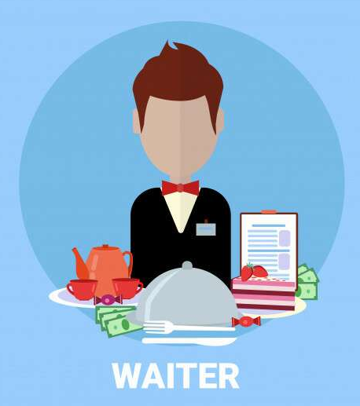
AC2.1
Describe the operation of
front of house.
Revision
Question mat
Name of operation
Entrance/ reception
Waiting room
Purpose
Importance to the success of business
Bar area
Dining area
Cloakroom
What are the reasons for using a front of house workflow system?
………………………………………………………………………………………………………………………………………………………………………………………………………………………………………………………………………………………………………………
Where are you now?

Slide 6
AC2.1
Describe the operation of
the kitchen.
AC2.1
Describe the operation of
front of house.
Revision
Question mat
Complete the empty plan below to show what the workflow for coffee shop that serves afternoon teas (cakes/hot drinks/Sandwiches) FRONT OF HOUSE ONLY
Why is a staff uniform important ?
_____________________________________________________________________________________________________________________________________________________________________________________________________________________________________________________
Explain how the following headings relating to uniform.
START
Branding
Safety (staff)
Customer service
Safety (customer)
Hygiene
Reputation
FINISH
Where are you now?

Slide 7
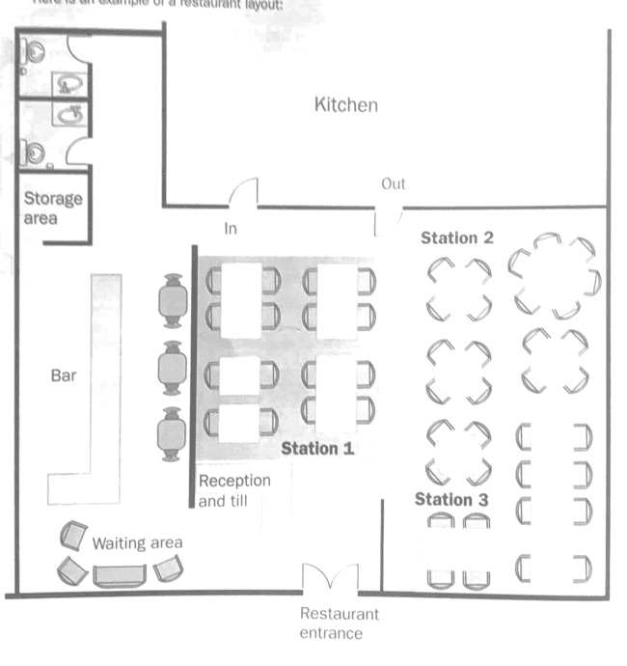
AC2.1
Describe the operation of
front of house.
Revision
Question mat
Factors determining restaurant layout
Task – Explain and annotate how the restaurant has been planned. Give advantages and disadvantages. Give recommendations to improve the layout
Would you change the layout for a fast food restaurant?
Explain how the layout of a restaurant can enhance the customer experience?

Slide 8
AC2.1
Describe the operation of
front of house.
Revision
Question mat
Food Service
Waiting at table
Front of house equipment
Table Tops
Customer seating
Organisation
First aid and safety
Bar area
What is meant by food service equipment
What does EPOS stand for?
___________________________________________________________________________________________________________________________________________________________________________________________________________________
____________________________________________________________________________________________________________________________________________________________________________________________________________________________________________________________________________________________________________________________________________________________________________________________
___________________________________________________________________________________________________________________________________________________________________________________________________________________

Slide 9
AC2.1
Describe the operation of
the kitchen.
Revision
Question mat
___________________________________________________________________________________________________________________________________________________________________________________________________________________________________________________________________________________________________________________________________________________________________________________________________________________________________________________________________________________________________________________________________________________________________________________________________________________________________________________________________________________
Explain to a new apprentice chef why FIFO is important?
What does FIFO stand for?
What is the role of a stock controller?
________________________________________________________________________________________________________________________________________________________________________________________________________________________________________________________________________________________________________________________________________________________________________________________________________________________________________________________________________________________________________________________________________________________________________________________________
________________________________________________________________________________________________________________________________________________________________________________________________________________________________________________________________________________________________________________________________________________________________________________________________________________________________________________________________________________________________________________________________________________________________________________________________
Explain how an EPOS system helps control stock?
Does stock control only relate to food?
________________________________________________________________________________________________________________________________________________________________________________________________________________________________________________________________________________________________________________________________________________________________________________________________________________________________________________________________________________________________________________________________________________________________________________________________
How does poor stock control effect business?
Where are you now?

Slide 10
AC2.1
Describe the operation of
the kitchen.
AC2.2 Describe the operation of
front of house.
Task – Identify the different information that needs to be stored by the hospitality and catering industry. Add notes and sketches to the front of the folder.
Revision
Question mat
Discuss how keeping records of waste and profit is essential to being successful in the hospitality industry.
___________________________________________________________________________________________________________________________________________________________________________________________________________________________________________________________________________________________________________________________________________________________________________________________________________________________________________________________________________________________________________________________________________________________________________________________________________________________________________________________________________________
Discuss what records a Head chef would need to keep?
___________________________________________________________________________________________________________________________________________________________________________________________________________________________________________________________________________________________________________________________________________________________________________________________________________________________________________________________________________________________________________________________________________________________________________________________________________________________________________________________________________________
___________________________________________________________________________________________________________________________________________________________________________________________________________________________________________________________________________________________________________________________________________________________________________________________________________________________________________________________________________________________________________________________________________________________________________________________________________________________________________________________________________________
Discuss what
records a front of house manager would need to record?
Where are you now?

Slide 11
AC2.1
Describe the operation of
the kitchen.
AC2.2 Describe the operation of
front of house.
Task - Explain how the following factors can help customers and staff feel safe in the hospitality and catering industry
Write customer points in RED
Write staff points in Blue.
Revision
Question mat
Staff lockers
Safes for money
Security lighting
Locking doors and windows
CCTV
Safety and
Security
Lighting
Honest staff
Staff training
Secure outside fittings
Alarm system
Stock control
Keyholders for emergencies
Where are you now?

Slide 12
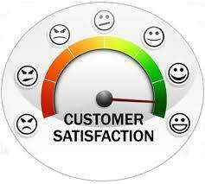
AC2.3
Explain how hospitality and
catering provision meet customer requirements.
Meeting customer requirements
Revision
Question mat
Add the customer requirements and expectation for the following customers.
Local
customer
What is meant by customer service?
What is meant by customer requirements and expectations?
________________________________________________________________________________________________________________________________________________________________________________________________________________________________________________________________________________________________________________________________________________________________________________________________________________________
________________________________________________________________________________________________________________________________________________________________________________________________________________________________________________________________________________________________________________________________________________________________________________________________________________________
There are three levels of customer requirements and expectations. Give examples
Business
customer
Leisure
customer

Slide 13
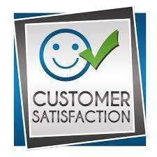
AC2.3
Explain how hospitality and
catering provision meet customer requirements.
Revision
Question mat
Mind map the customer requirements below:
Identify service symbols
What is meant by customer rights?
______________________________________________________________________________________________________________________________________________________________________________________________________________________________________________________________________________________________________________________________________________________________________________________________________________________________________________________________________________________________________________________________________________________________________________________________
Student Backpackers
Travel Europe
What is meant by equality?
Can you think of any other service symbols
______________________________________________________________________________________________________________________________________________________________________________________________________________________________________________________________________________________________________________________________________________________________________________________________________________________________________________________________________________________________________________________________________________________________________________________________
Wedding

