Slide 1
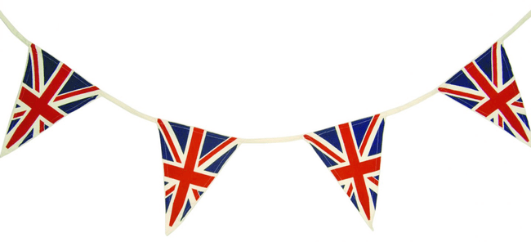
VE Day, 1945
Nôd y wers:
Dw i’n gallu/I can understand the events that took place on 8th May 1945 and plan a way to remember VE Day.

Slide 2
VE Day 75th Anniversary
The aim of this project is to help you learn about the events of VE Day in 1945 and plan your own stay at home VE Day party.
For the next week, the only History work you need to complete is this project.
There are lots of activities so make sure you upload each activity as soon as it is done rather than waiting until you have done it all. That way I can see what you’re getting up to throughout the week. ☺
Read through the whole PowerPoint first so you can see what will be required of you.
There are worksheets that you can use but they are not compulsory, you can choose to do these activities on a separate document if you prefer. They are just there as a guide to help you.
Have fun!

Slide 3
The End of World War Two
By the beginning of 1945, the German army had been weakened and defeat looked likely. In the spring of 1945, war with Germany was coming to an end.
8 May 1945 – VE (Victory in Europe) Day – was one that remained in the memory of all those who witnessed it. It meant an end to nearly six years of a war that had cost the lives of millions; had destroyed homes, families, and cities; and had brought huge suffering to the populations of entire countries.

Slide 4
Germany’s Surrender
On 30th April, with Berlin surrounded by the Allies, Adolf Hitler committed suicide.
Hitler’s named successor, Grand Admiral Karl Dönitz, now began negotiations to end the war with the Allies.
The news of Germany’s surrender was not surprising. It had been anticipated for some time and people across Britain were on standby to start celebrating the end of the war.

Slide 5
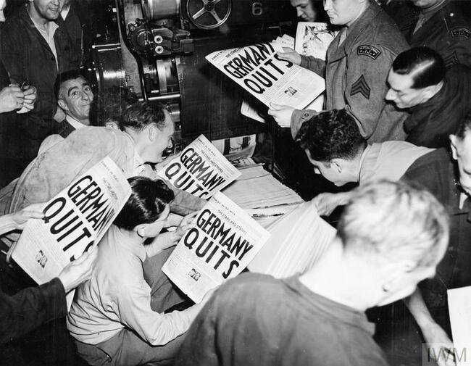
Germany’s Surrender
The announcement that the war had ended in Europe was broadcast to the British people over the radio late in the day on 7th May.
The BBC interrupted its scheduled programming with a news flash announcing that Victory in Europe Day would be a national holiday, to take place the following day.
Newspapers ran the headlines as soon as they could, and special editions were printed to carry the long-awaited announcement.
The news that the war was over in Europe soon spread like wildfire across the world.
Watch this ‘HEAR: The sounds of VE Day’ clip: https://www.bbc.co.uk/teach/ve-day-How-did-the-british-plan-to-celebrate/zndn7nb

Slide 6
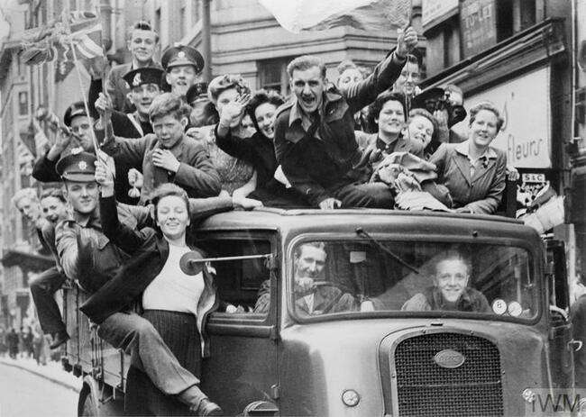
Time to Celebrate!
Many people in Britain didn't wait for the official day of celebration and began the festivities as soon as they heard the news on 7th May.
After years of wartime restrictions and dangers – from food and clothes rationing to blackouts and bombing raids – it was understandable how eager they were to finally be able to let loose and enjoy themselves.

Slide 7
A National Holiday
A national holiday was declared in Britain for 8 May 1945.
In the morning, Churchill had gained assurances from the Ministry of Food that there were enough beer supplies in the capital and the Board of Trade announced that people could purchase red, white and blue bunting without using ration coupons.
There were even commemorative items hastily produced in time for the celebrations, including VE Day mugs. Some restaurants had special ‘victory’ menus, too.

Slide 8
How did people celebrate?
Many people were extremely happy that the fighting had stopped and there were big celebrations and street parties.
Huge crowds - with lots of people dressed in red, white and blue - gathered outside Buckingham Palace in London. They cheered as King George VI and his family, including Princess Elizabeth (the current queen) and Princess Margaret, came out onto the balcony to greet everybody.
Princess Elizabeth and her sister were allowed to leave the palace and celebrate with crowds outside, although they had to do it secretly.
The future Queen described it as "one of the most memorable nights of my life".
Many people also attended church services to thank God for the victory.

Slide 9
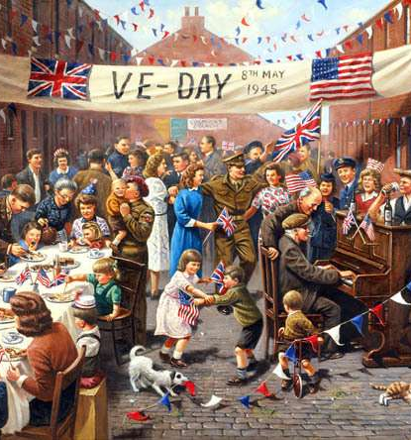
TASKS:
Look at the different people represented in this image.
What are they doing?
Why are they doing this?
What emotions might each of them be feeling?

Slide 10
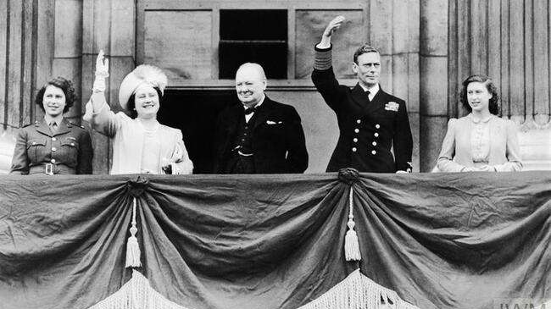
TASKS:
Why did the Prime Minister and Royal Family make an appearance on the balcony of Buckingham Palace? Why did people want to see this?
What is Princess Elizabeth (far left) wearing? Why?
What role have Prime Minister Johnson and Queen Elizabeth played during this period of crisis that were are currently going through in our fight against Covid-19?

Slide 11
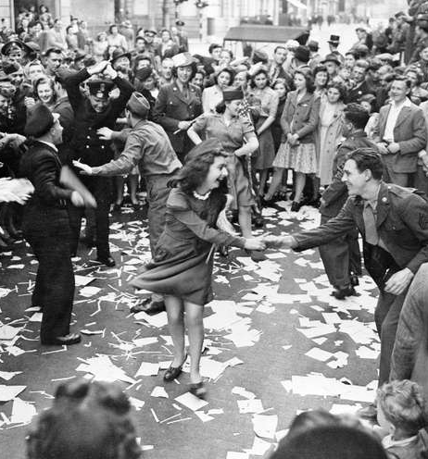
The VE Day celebrations continued well into the night. The largest crowds in Britain were in London, but people all around the country took part in the parties, singing and dancing. Many bonfires and fireworks were lit to mark the occasion.
An estimated 50,000 people were crowded around Piccadilly Circus by midnight. The joy of the day broke down normal social conventions, and people spoke to and embraced those whom they had never met before. Music was provided by gramophones, accordions and barrel organs, and revellers sang and danced to the popular tunes of the day. Licensing hours were extended so that people could toast the end of the war with a drink (or two), and dance halls stayed open until midnight.
TASKS:
Describe what is happening in this image.
Pick one person. Describe how you think they may be feeling. What might that have been through over the past few years?

Slide 12
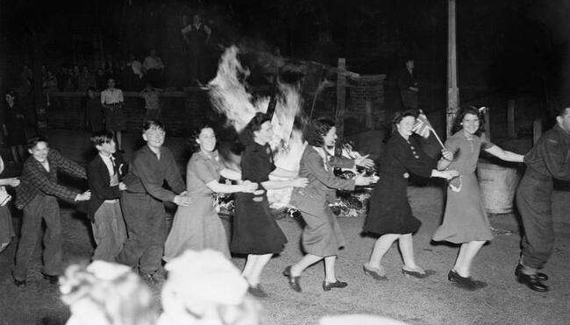
TASKS:
What are these people doing?
When/where would you normally do this?
What does this reveal about this occasion?

Slide 13
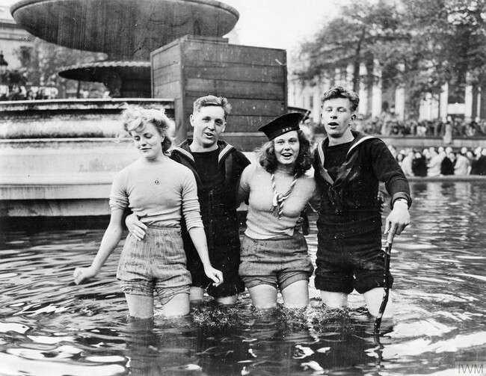
https://www.iwm.org.uk/history/who-were-the-women-in-the-trafalgar-square-fountains-on-ve-day
The Fountains at Trafalgar Square
TASK:
This is an iconic photograph that has been used across the world to highlight the celebrations on VE Day.
Who were these women?
Follow this link to read all about them.
Produce a fact file to explain more about this image and the people in it.

Slide 14
Winston Churchill
Winston Churchill was the man of the hour on VE Day. Britain’s Prime Minister had been a major driving force behind the Allies’ victory over Nazi Germany and, now that peace had come, the British people were keen to celebrate it with him.
At 3pm on VE Day, Churchill made a national radio broadcast. In it, he announced the welcome news that the war had ended in Europe but he included a note of caution as he knew that the war was not over.

Slide 15
This was not the end…
VE Day was also a moment of great sadness and reflection, as millions of people had lost their lives or loved ones in the conflict.
Many had to continue fighting in other battles and lots of people were being kept as prisoners of war abroad.
Even though VE Day marked victory for Europe over Germany, it did not mark the end of World War Two.
In his VE Day announcement, Winston Churchill said: "We may allow ourselves a brief period of rejoicing, but let us not forget for a moment the toil and efforts that lie ahead."
Even after 8th May, many soldiers, sailors and pilots were sent to the east to fight against the Japanese, who had not yet surrendered.

Slide 16
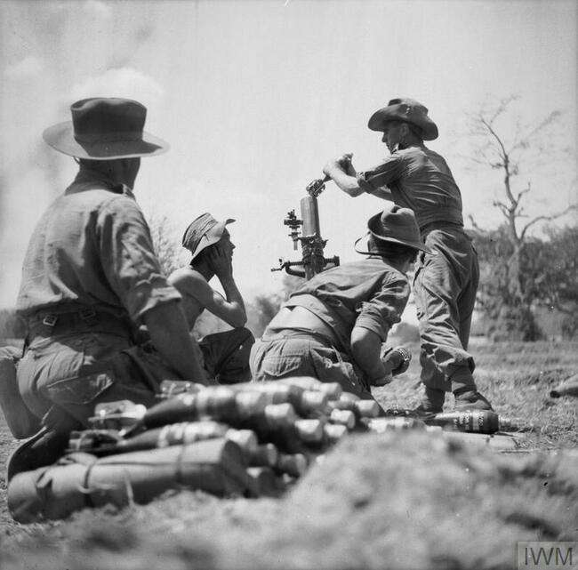
The Far East and the Pacific
For members of the Allied forces who were still serving overseas on VE Day, the occasion was bittersweet. Although it meant victory in one theatre, the war was not yet over in the Far East and Pacific.
The final months of the war in the Pacific saw heavy casualties on both sides, but ultimately ended in victory for the Allies. Japan’s leaders agreed to surrender on 14th August and the act of surrender was signed on 2nd September.
For people in Britain, the end of the fighting didn’t mean an end to the impact of the war on their lives. Although many things slowly began to return to normal, it took time to rebuild the country and shortages were still felt: clothes rationing lasted until 1949 and food rationing remained in place until 1954.

Slide 17
2020: 75th Anniversary
Next Friday (8th May) marks the 75th anniversary of VE Day.
Understandably, planned events across the country have been cancelled. However, a number of events have been organised to help us commemorate and celebrate within the confines of lockdown and social distancing, including:
a live VE Day 75 livestream at 11.15am;
national moments of remembrance and thanksgiving, including a two minute silence;
a UK-wide singalong to Vera Lynn’s ‘We’ll Meet Again at 9pm; and
an evening of memories and music from 8pm on BBC One.

Slide 18
VE Day 75th Anniversary
TASK: Create a peace display or note of thanksgiving.
Explain the reasons that you are thankful to past generations.
Encourage people to be kind to each other.
Learn the word ‘peace’ in as many languages as you can.
Display your poser somewhere prominent so as many people as possible can see it.
Be really creative! I want these posters to be eye catching and colourful.
Don’t forget to send me examples and photos of your posters.

Slide 19
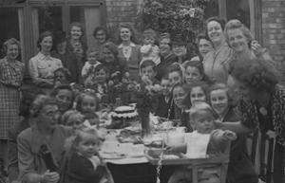
VE Day 75th Anniversary
We may be experiencing lockdown and social distancing but that does not mean that you and you family cannot celebrate as a household. For example, I (Mrs Evans) am planning a stay at home VE Day party for my lockdown household.
Make some bunting and British flags, dress up in 1940s style clothing, bake some cakes and treats using rations and throw your own mini-VE Day party at home.
Upload your plans and photos to Google Classroom so I can see the amazing things you are doing! I want to Tweet your plans and posters throughout the week so upload pieces as soon as they are complete please. I will then Tweet photos of your parties on Friday and over the weekend. Let me know if you don’t want me to Tweet your work/photos. I won’t include names. ☺
If you don’t want to throw a party for your household that’s ok but still think about how you could throw a party and upload your plans to Google Classroom.

Slide 20
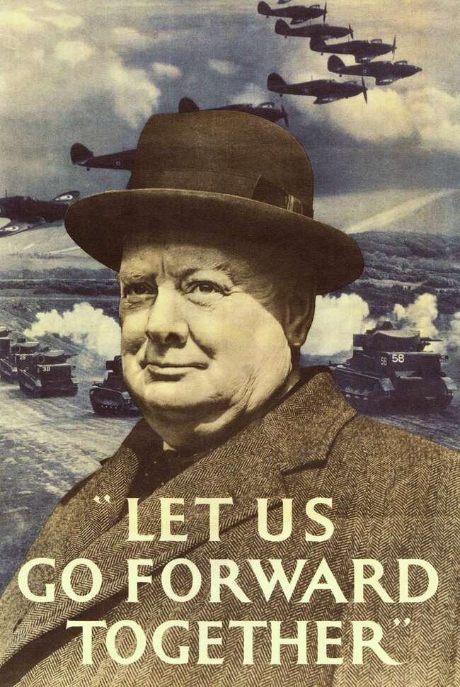
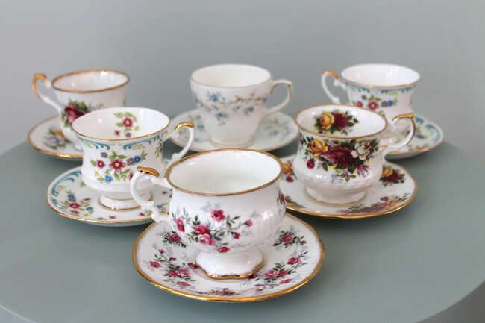
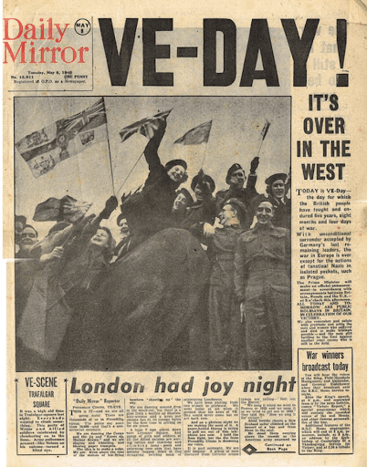
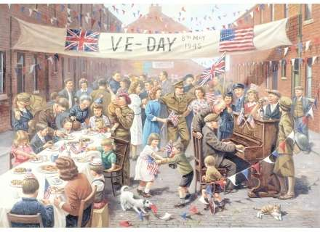
VE Day 75th Anniversary
How will you decorate?
Print out or draw your own British flags and flags of the Allies and hang them from the trees or across the fence in your garden (or inside if it rains!)
Find some red, blue or white table clothes (or even bed sheets) to cover your table.
Route around in the cupboards to find some ‘old fashioned’ cups & saucers, plates and cake stands.
Make propaganda posters and newspaper front pages and put them up on the walls. You could even tea stain them for an authentic look!

Slide 21
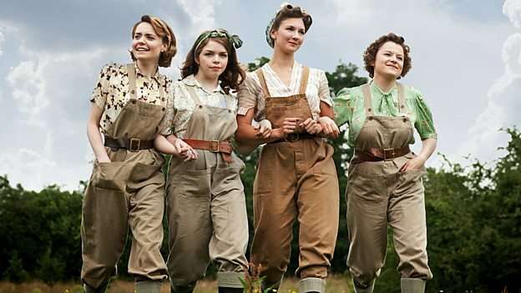
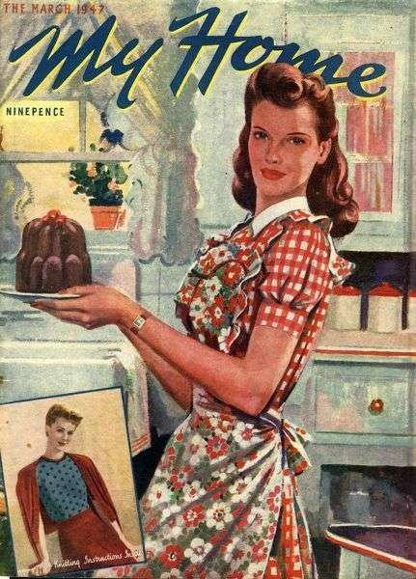
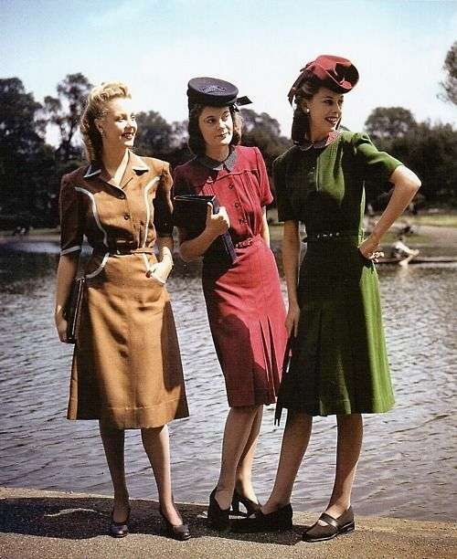
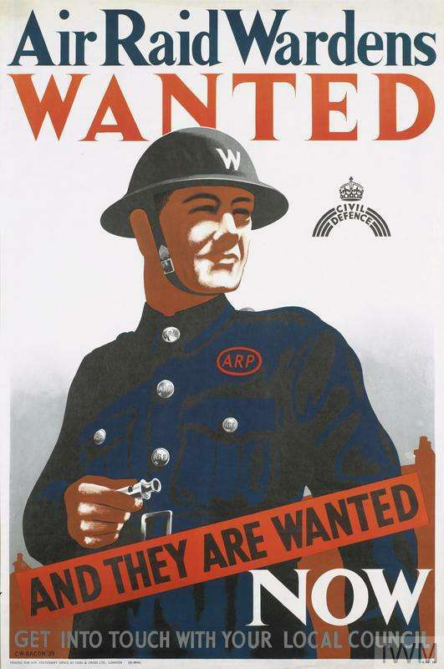
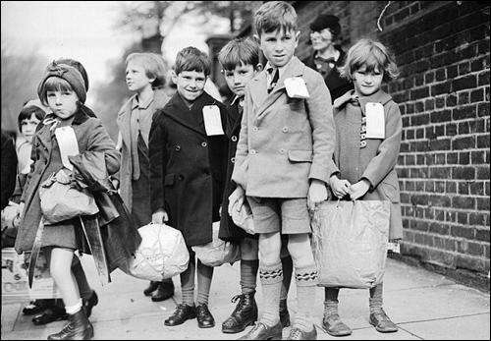
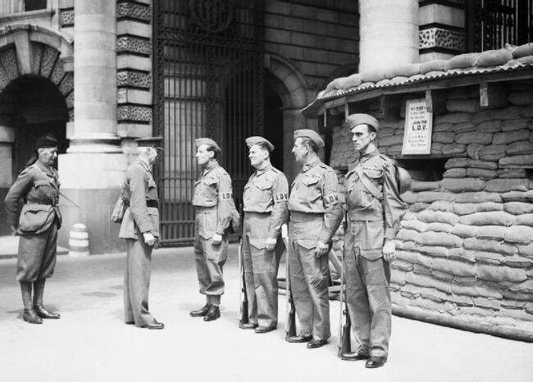
VE Day 75th Anniversary
What will you wear?
Have a look through the wardrobes and see what homemade fancy dress outfits you can create.
Get the whole family involved with a character for everyone. Evacuated children who have returned home, women who worked in the factories or on the land, ARP wardens, Home Guard soldiers and general fashion from the 1940s!
If you don’t want to dress up, everyone could wear red, white and blue.

Slide 22
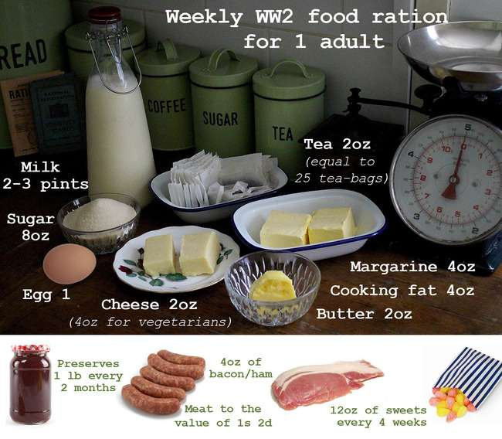
VE Day 75th Anniversary
What will you eat?
Although Winston Churchill had made sure there was going to be enough beer for the celebrations, the food that was served at street parties would have been dictated by rationing.
Plan a menu based on the food that would have been available. Take photos of the food you make and attach them to the menu (this will be a great keepsake for your time capsule).
Have a go at making a cake using rations.

Slide 23
VE Day 75th Anniversary
We are all going through a very strange period at the moment. Although this won’t change what is happening, let’s try and lift everyone’s spirits by getting involved and celebrating the 75th anniversary of VE Day.
Make sure you upload or email your work and photos to me throughout the week so we can show everyone what you’re doing. Let’s try and channel a little bit of that Blitz Spirit!
I want you to have fun with this project and put lots of effort into it.
I can’t wait to see what you all get up to! ☺
Remember, work hard and stay safe.
EvansL1465@Hwbcymru.net

